Slide 1
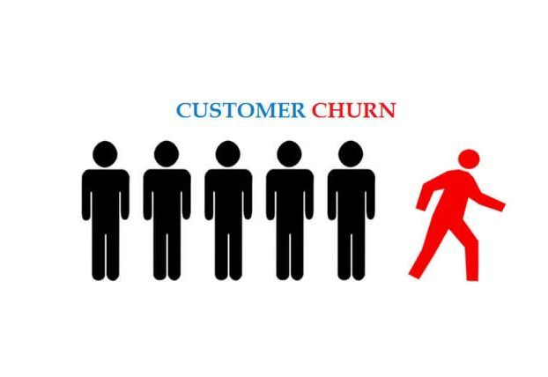
Customer Churn Analysis- Group Project
-Ancy Ann
-Maria Median
-Abhijit Avhad

Slide 2
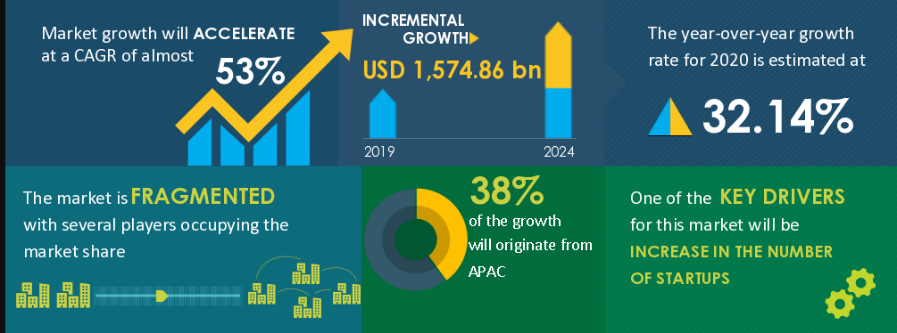
WHY
CUSTOMER CHURN?
Name – Customer Churn Analysis (Churn Meaning – Attrition)
Background –
Service companies growing exponentially
Online services major chunk
Customer membership key to capture market share

Slide 3

SOURCE OF DATA
KKBOX offers subscription-based music streaming service. When users signs up for the service, users can choose to either manual renew or auto-renew the service. Users can actively cancel their membership at any time.
In this dataset, KKBox has included more users' behaviors, in order to enable participants to explore different user behaviors outside of the train and test sets. For example, a user could actively cancel the subscription, but renew within 30 days.

Slide 4

KEY QUESTIONS TO ANSWER
Identify the key features and their combinations from the data that are the major contributors in the accuracy of the prediction.
Find the correlation amongst these feature.
Explore the model to find demographic groups that can be a focus area for the company to implement improved strategies
Also groups that have a probability to stay can help to learn what drives that decision

Slide 5
DATA EXPLORATION
 | Member Initial Details.csv | Transactions.csv | User Log.csv | Train Dataset.csv
Columns | Customer ID, City, Age, Gender, Registered_Via, Registered_On | Customer ID, Payment_Method_ID, Payment_Plan_Days, Plan_List_Price, Actual_Amount_Paid, Auto_Renewed, Transaction_Date, Membership_Expire_Date, Cancelled | Customer ID, Date_Streamed, Less_than_25, Less_than_50, Less_than_75, Less_than_99, Less_than_50, Above_99, Unique_Songs, Total_Secs | Customer ID, Is_Churn
Data Type | VarChar: Customer ID | VarChar: Customer ID | VarChar: Customer ID | VarChar: Customer ID
 | Numeric: City, Age, Registered_Via, Registered_On | Numeric: Payment_Method_ID, Payment_Plan_Days, Plan_List_Price, Actual_Amount_Paid, Auto_Renewed, Transaction_Date, Membership_Expire_Date, Cancelled | Numeric: Date_Streamed, Less_than_25, Less_than_50, Less_than_75, Less_than_99, Less_than_50, Above_99, Unique_Songs, Total_Secs | Numeric: Is_Churn
 | Character: Gender

Slide 6
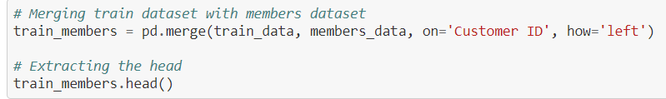
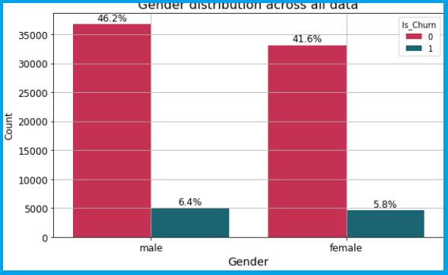
DATA ANALYSIS
Each datasets are merged with train dataset for checking the churn rate in each categories.

Slide 7
DATA ANALYSIS - IMPORTANT OUTCOMES
Decoded the age group into groups, 0 represent [0-10], 1 represent [10-20], 2 represent [20-30], 3 represent [30-40], 4 represent [40-50], 5 represent [50-60], 6 represent [60-70] and 7 represent [70-80].
The most number of customers are from age group ranging from 1-4 that represents youngsters.
While considering the registration year distribution against churn data, from year 2010, registration is increased except 2014.
There are almost 54% of users who uses 41st payment method.
But for payment methods 8, 12, 13, 22, 35, 20, 17 15 and 32 there is high churning rate.
Almost a million of users [94.50%] purchased 30 days subscription, while only fewer purchased the rest of the plans.
Besides 30 days plan, the users who purchased another plan have very high tendency to leave the service.
Lot of users (almost 94.25%) have their plan price 99,100, 129, 149 and 180 NTD.
Decide these five values if a user purchases any other plans, then there is a very high tendency of leaving.

Slide 8
MACHINE LEARNING MODEL
Logistic Regression is a classification algorithm used to find the probability of event success and event failure.
Advantages:
Easily extend to multiple classes
Efficient to train.
Disadvantages:
The assumption of linearity between the dependent variable and the independent variables.
It is tough to obtain complex relationships using logistic regression
K-Means is a unsupervised algorithms that groups similar data points together and discover underlying patterns.
Advantages:
Scales to large data sets.
More intuitive clustering
Disadvantages
Difficult to predict K-Value
Centroids can be dragged by outliers.
Features to pay attention to:
City,
Age,
Gender,
Less_than_25, Less_than_50,
Less_than_75, Less_than_99,
Less_than_50, Above_99,
Unique_Songs,
Total_Secs
Auto_Renewed,
Actual_Amount_Paid,

Slide 9
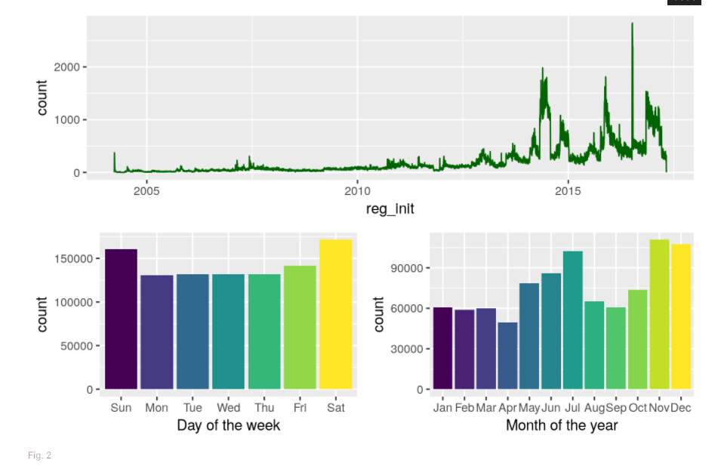
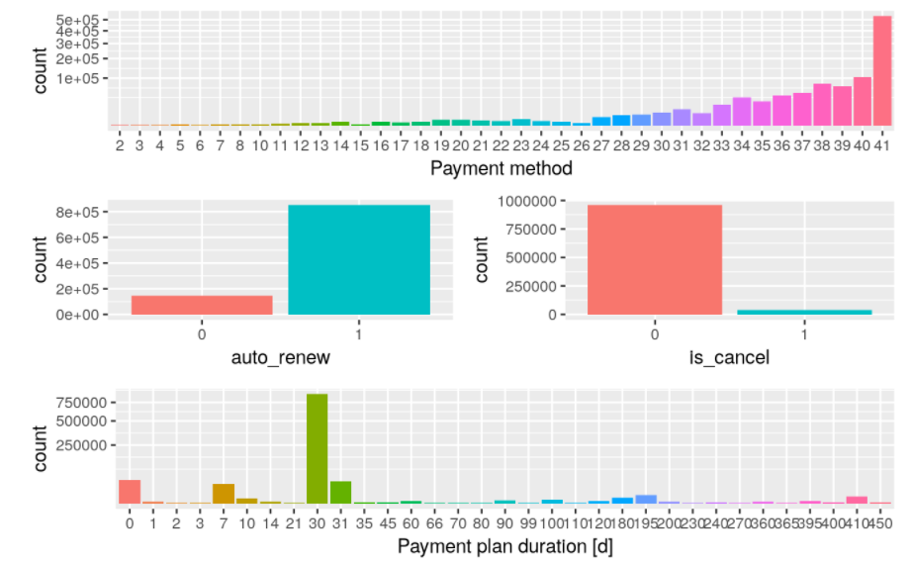
DASHBOARD
The Dashboard will be created using Tableau to begin with. We will explore TabPy to enhance if needed
Individual Data Visualisation
Machine Learning results visualisation
Interactive Element - Filtering categories like Gender, Age, City

